Slide 1

Note: The data and information in this document is reflective of a hypothetical situation and client. This document is to be used for KPMG Virtual Internship purposes only.
Sprocket Central Pty Ltd
Data analytics approach
[Division Name] - [Engagement Manager], [Senior Consultant], [Junior Consultant]

Slide 2
Note: The data and information in this document is reflective of a hypothetical situation and client. This document is to be used for KPMG Virtual Internship purposes only.
Agenda
Introduction
Data Exploration – discovering relationships between data & features
Model Development – data transformations & modelling
Interpretation – reporting of key findings

Slide 3
Note: The data and information in this document is reflective of a hypothetical situation and client. This document is to be used for KPMG Virtual Internship purposes only.
Introduction
New customers analysis
These are the features used for recommendation to the new customers:
Age distributions
Number of purchases in 3 years
Job industry category
Customer’s State
Customer’s Wealth segments
Product size and highest selling brands

Slide 4
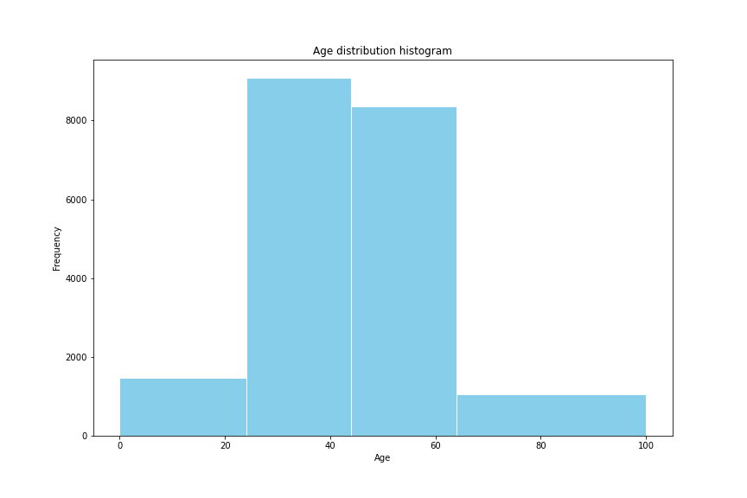
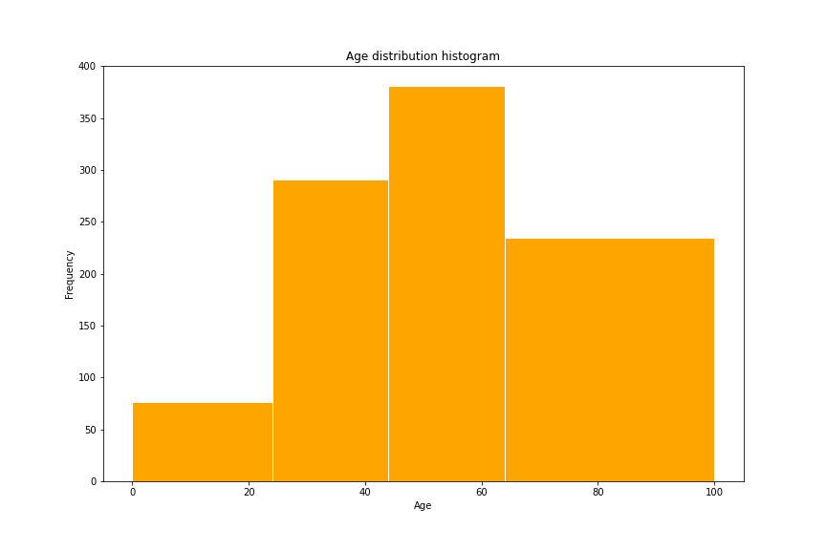
Note: The data and information in this document is reflective of a hypothetical situation and client. This document is to be used for KPMG Virtual Internship purposes only.
Data Exploration
Customers’ age distribution
The percentage of <25 is similar to the original customer groups.
There are fewer customers in the age group 25-44 years old.
Most new customers are in the age group 45-64 years old.
There are much more customers in the age group >=65.

Slide 5
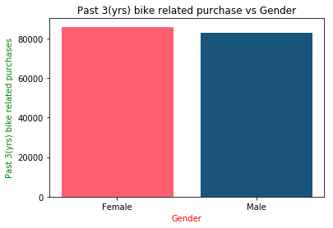
Note: The data and information in this document is reflective of a hypothetical situation and client. This document is to be used for KPMG Virtual Internship purposes only.
Model Development
Bike purchase in last 3 years
As we can see, our new customers mostly Female with 50.6% purchases with total of 25,212 bikes
Male contributed to 47.7% purchases with 23,765 bikes
So we should focus on advertises on Female customers & exciting offers for female.

Slide 6
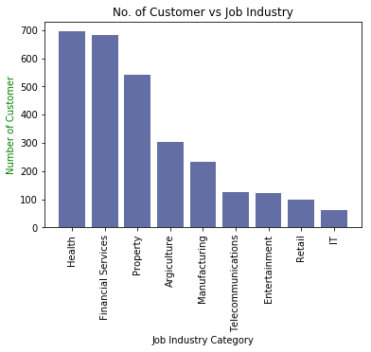
Note: The data and information in this document is reflective of a hypothetical situation and client. This document is to be used for KPMG Virtual Internship purposes only.
Interpretation
Job Industry Category
Most customers belongs to Health and Finance Services.
Focus to attract health or finance industry and mainly female customers.
There is very lesser chance of a new customer from IT and retail industry.

Slide 7
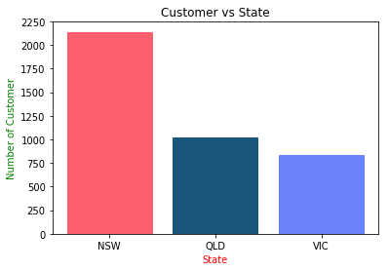
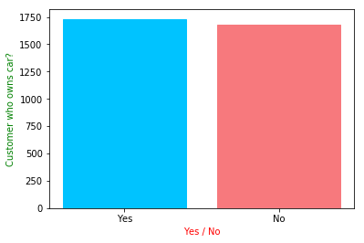
Note: The data and information in this document is reflective of a hypothetical situation and client. This document is to be used for KPMG Virtual Internship purposes only.
Interpretation
Numbers of cars owned in each state
Most customers are from New South Wales (NSW)
Also most customers have car.
So, our prime focus on resident of NSW who owns car.

Slide 8
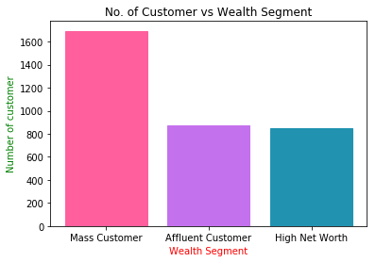
Note: The data and information in this document is reflective of a hypothetical situation and client. This document is to be used for KPMG Virtual Internship purposes only.
Interpretation
Customer Wealth Segment
In all ages, the number of Mass Customers is the highest so we should focus on this class of society.
After that, we should focus on Affluent Customer.
There is tiny difference in high net and affluent customers, so we should focus on both.

Slide 9
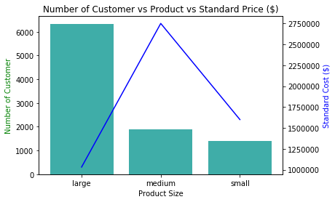
Note: The data and information in this document is reflective of a hypothetical situation and client. This document is to be used for KPMG Virtual Internship purposes only.
Interpretation
Product Size
Large number of customers purchased large size product.
Focus on large size product customers mainly female and resident of NSW.
Also focus on cost of large size product because one of the main reason of their highest selling is low pricing.

Slide 10
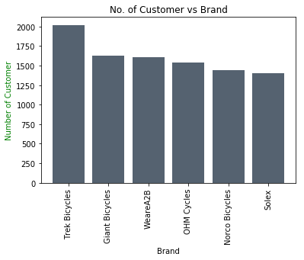
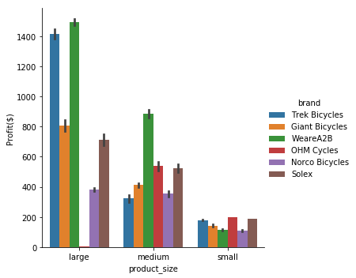
Note: The data and information in this document is reflective of a hypothetical situation and client. This document is to be used for KPMG Virtual Internship purposes only.
Interpretation
Highest selling brands
Trek Bicycles are highest selling brand in all of brands.
Advertise trek bicycles more with female models
Also all product size of trek cycles are profitable.

